Slide 1
Sessions & Cookies
Persisting data across requests

Slide 2

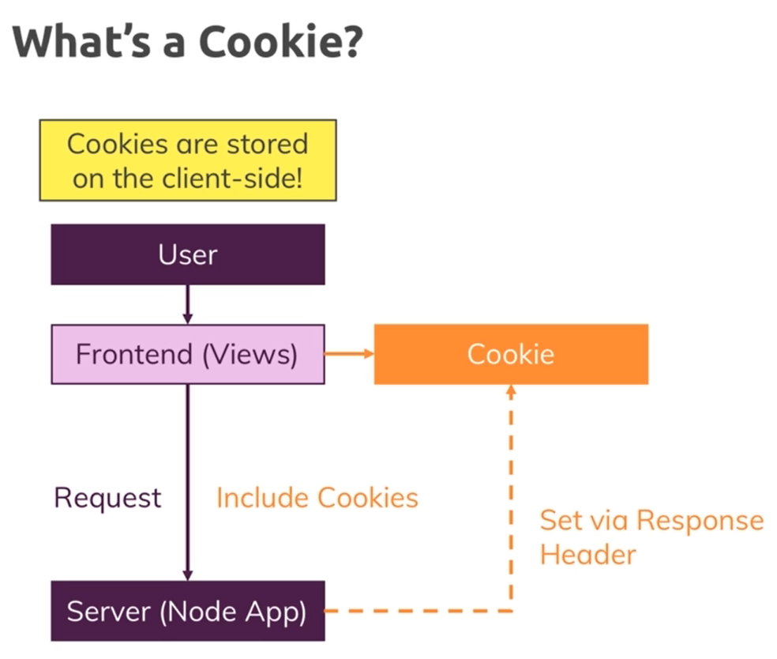



What is a cookie

Slide 3
Configuring cookies

Slide 4
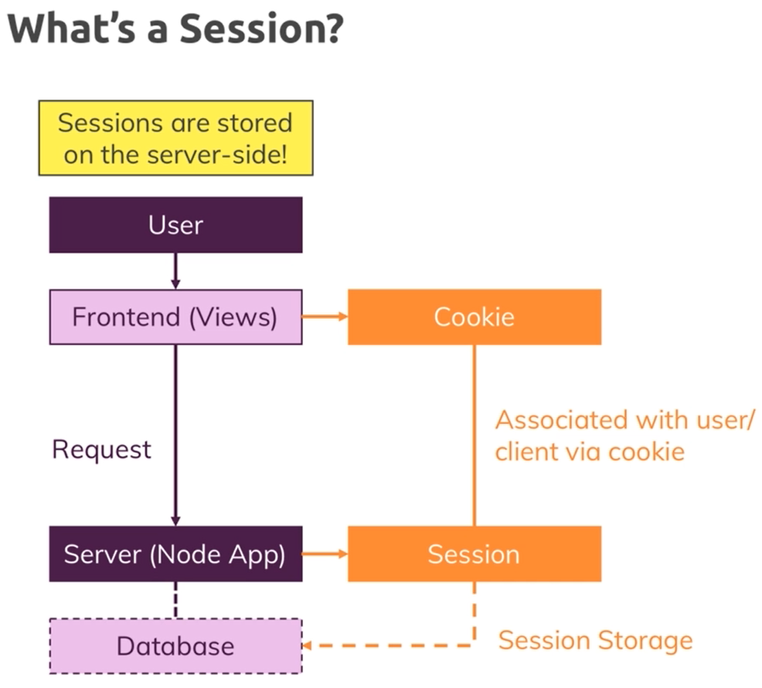
What is a session?

Slide 5
A complete example

